Slide 1
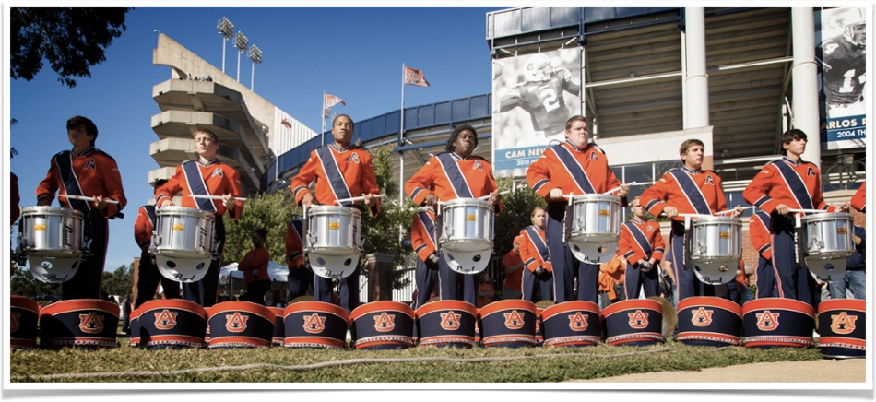
Statistical Analysis
for Marching Band Drum Core Improvement
Auburn Drumline
Daniel Willis

Slide 2
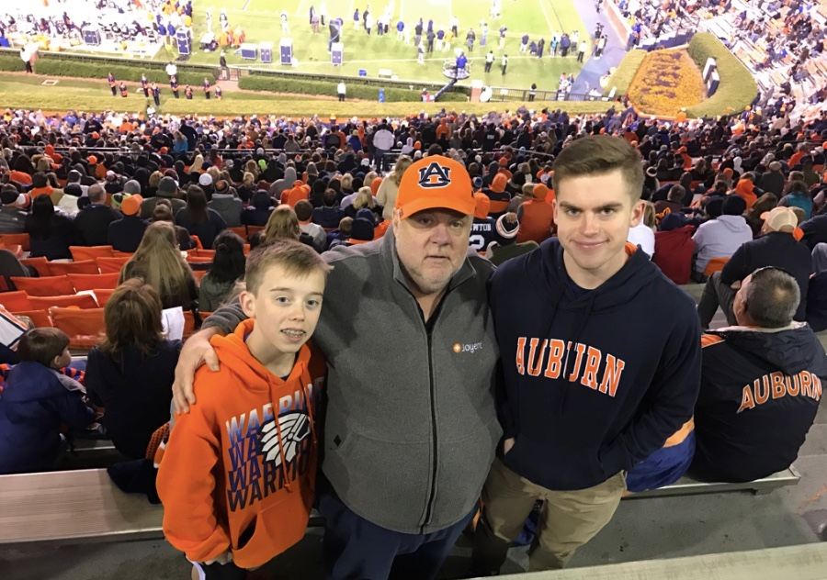
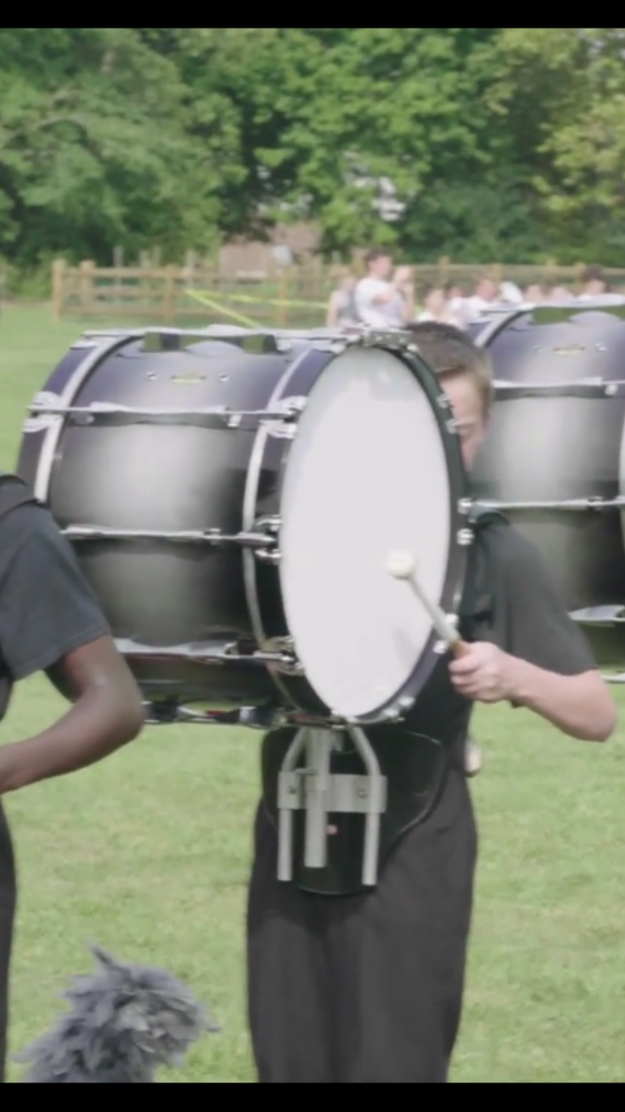
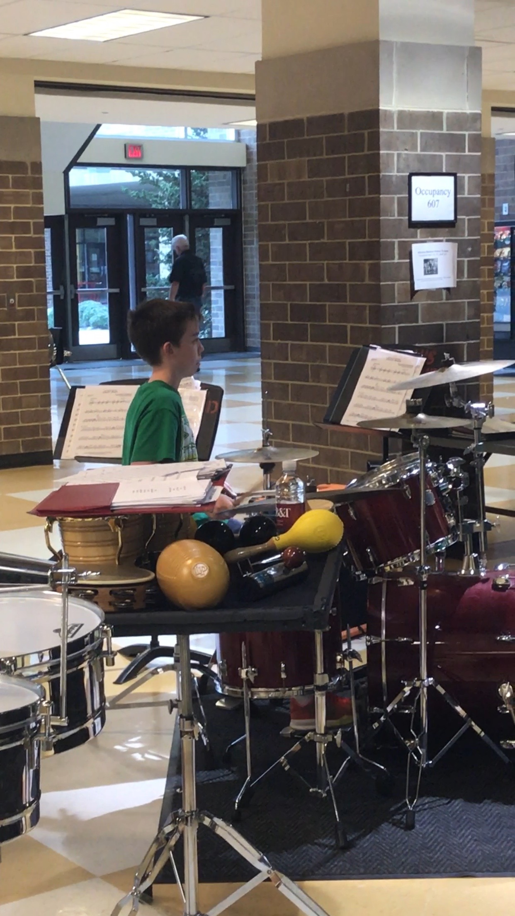
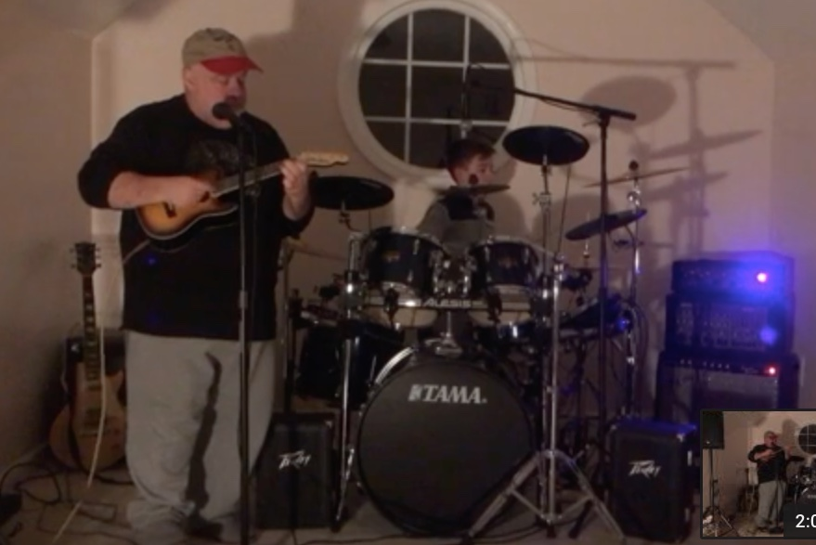

Slide 3
Bio
15 Year old freshman in High School
I’m in the Marching Band and Concert Band
Playing drums for 5 years
I also play rock N Roll Drums with my father
I have been to SCALE 5 times and spoke the past 3 years
Professionally speaking since I was 12
Spoken at Dockercon, O’Reilly Velocity and multiple Devopsdays

Slide 4
Outline
The Idea
Demonstration (recording a diddle exercise)
Audacity
History
Digital Signal Analysis
Statistical Analysis (Improvement)
Summary (What I learned)

Slide 5
The Idea
Record the same diddle sequence over a three month period.
Use audio tools to extract timings, tempo and beat signals.
Use statistical tools to look for patterns of improvement over time.

Slide 9
Demo

Slide 10
History

Slide 11
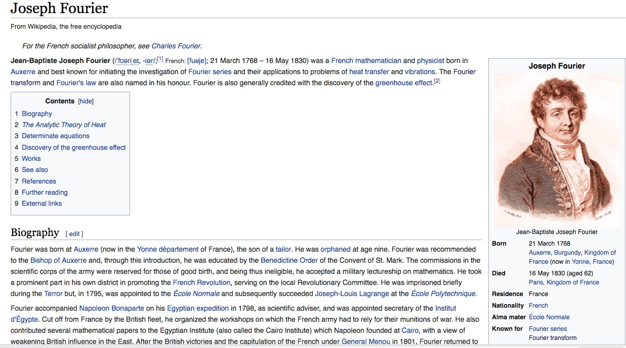
Considered the Father of Digital Music

Slide 12
Digital Signal Analysis

Slide 13
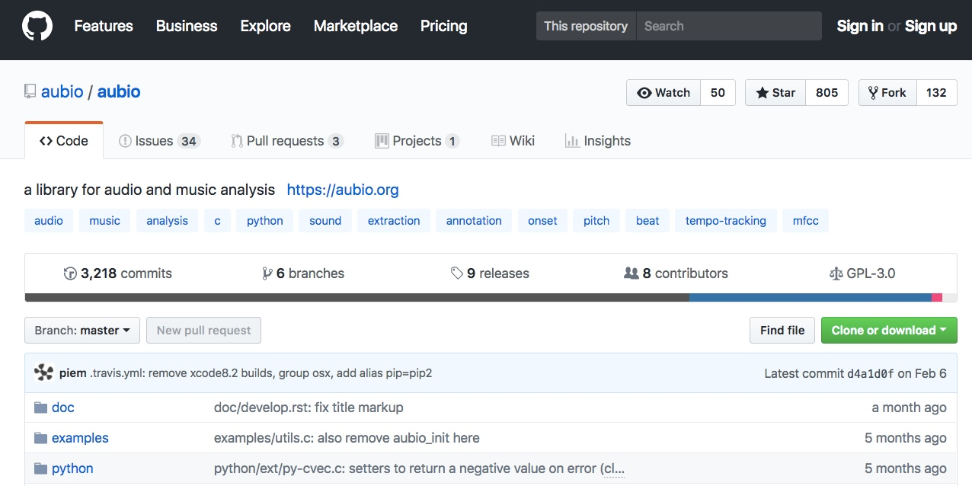

Slide 14
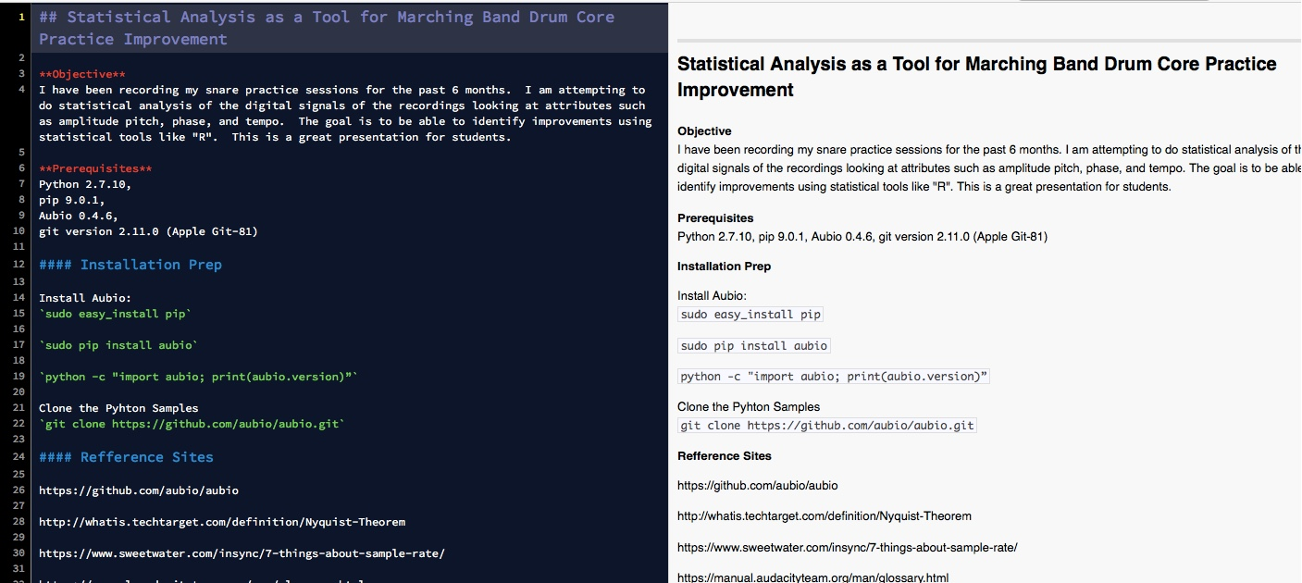

Slide 15
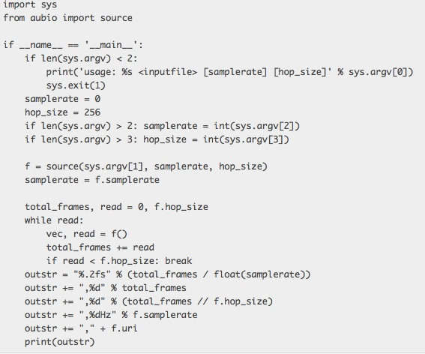

Slide 19
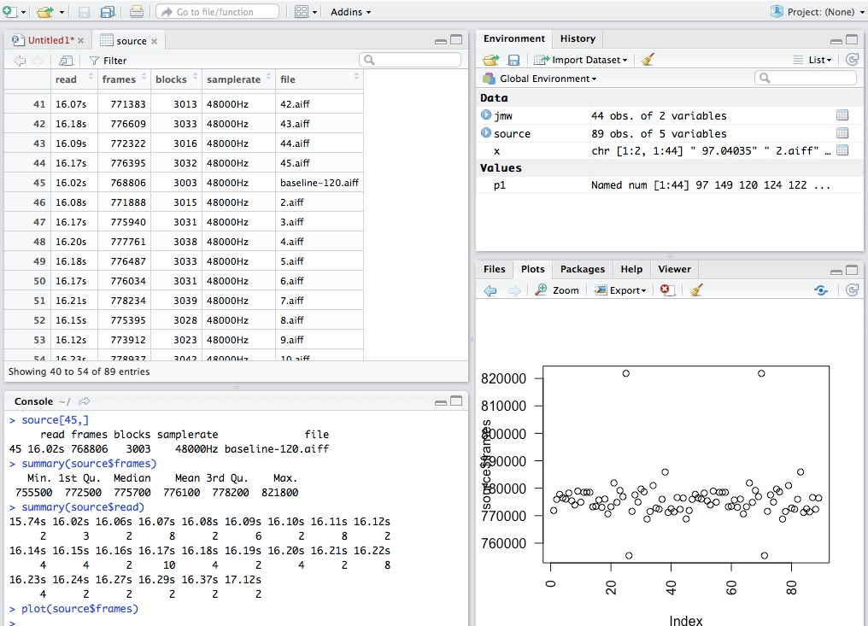

Slide 26
Looking and Temp and Beats

Slide 27
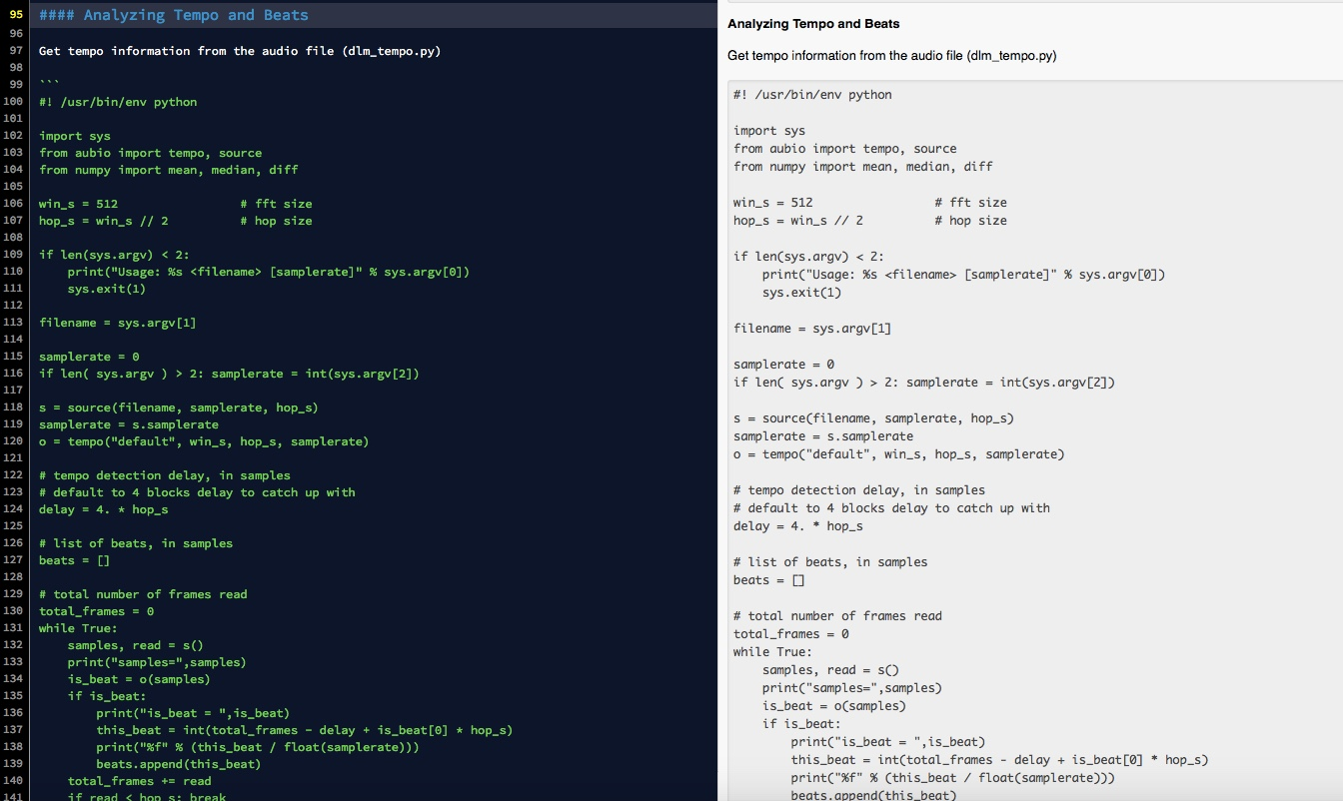

Slide 28
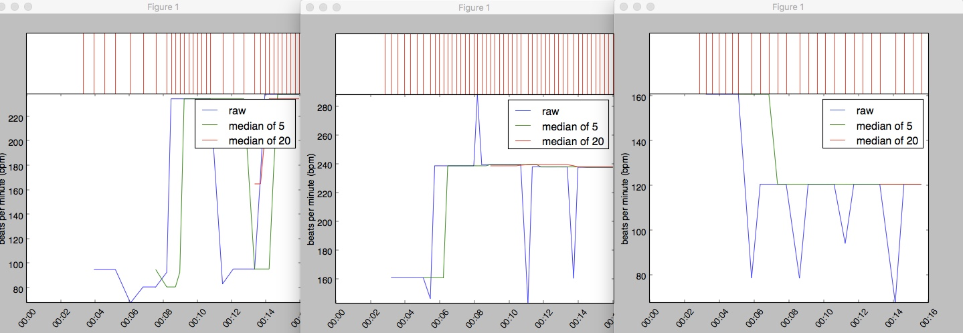
Day 1
Day 54
Baseline

Slide 29
Summary

Slide 30
Summary
Although the data didn’t show us exactly what we were hoping… it did tell us that we are on the right track.
Next time we are going to record digital practices files as opposed to analog files.
We are going to look for more improved tools (aubio was great but is very new and appear to be a little buggy)
Also Audio as far as we can tell was designed more for music and not drum beats.

